Slide 1
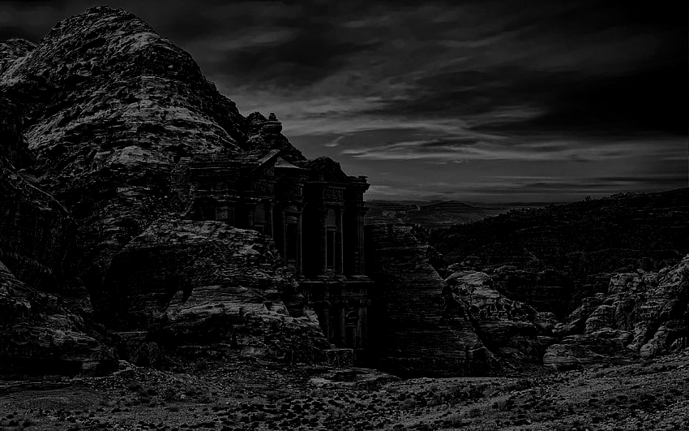
RINGS AND ASHES
By Shoji Alhilali, Luis Hernandez, and Will Scywick

Slide 2
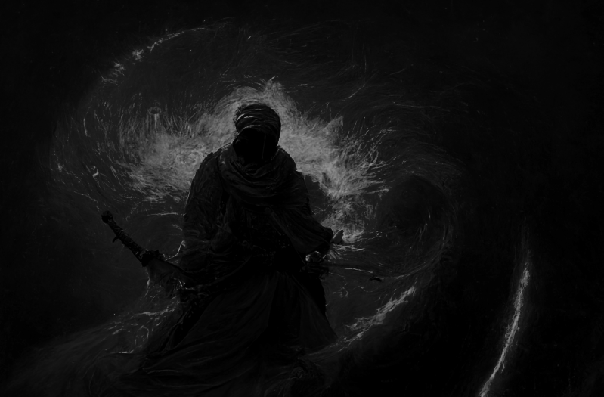
Story
Rakem Ibn Qamar gets captured by a demon.
Rakem gets free and kills the demon.
Demon dies and a gun magically appears.
A prisoner informs Rakem of the gun’s intended use and origin.
Gun Is Called “Ghubar,” or Ash
Rakem needs to kill every demon in the temple.

Slide 3
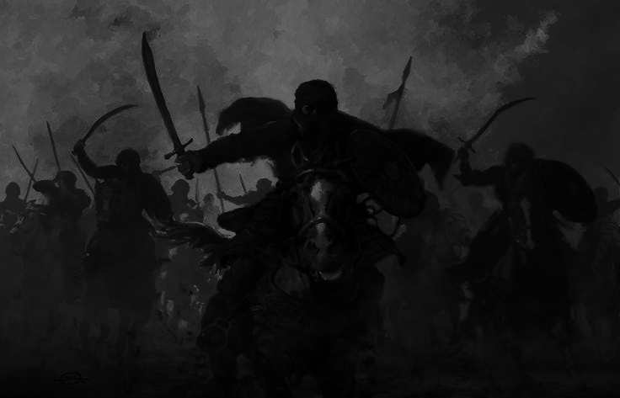
Selling Points
Gameplay
Bloodborne-inspired Souls 2D game.
Arabian mythology and legendary demons/monsters.
Arena fights.
Attack Via Sword
Shoot Rings Via Gun
Move Right and Left.

Slide 4
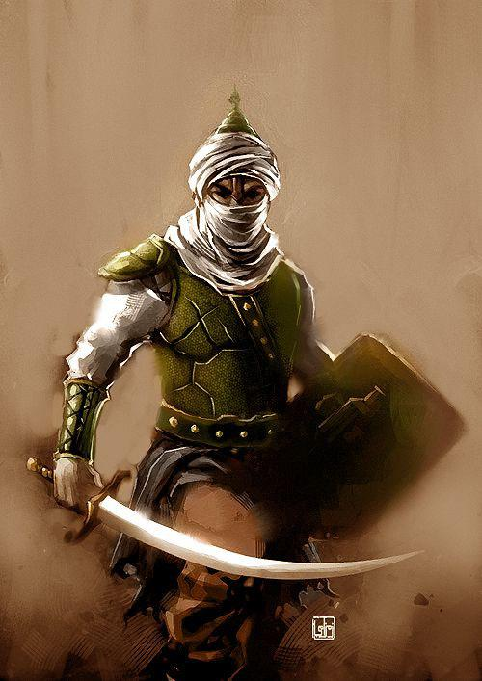
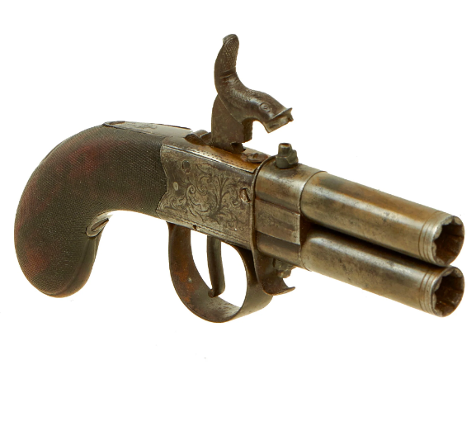
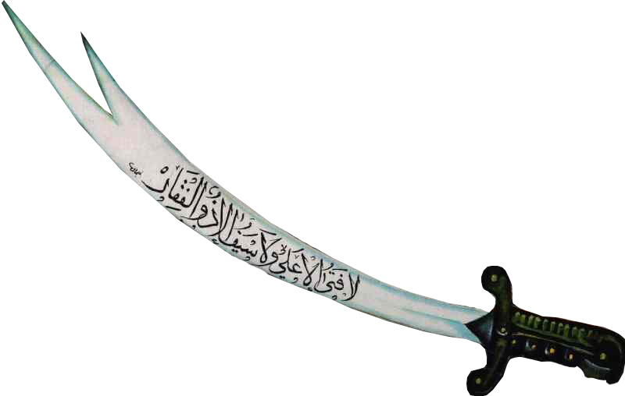
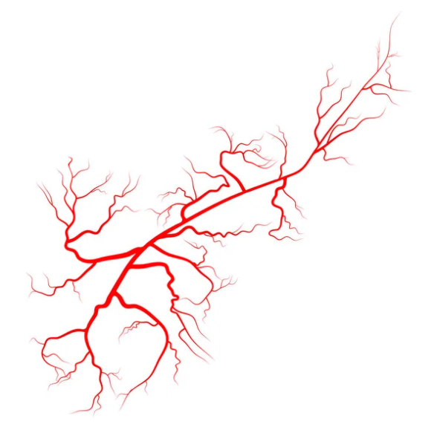
Double Barrel Turnover
Pocket Percussion Pistol
Zulfiqar Inspired Sword
Red Bloody Veins
Indicating Demon Infection
Rakem Ibn Qamar Gear Infographic

Slide 5
Double Barrel Turnover
Pocket Percussion Pistol
Zulfiqar Inspired Sword
Red Bloody Veins
Indicating Demon Infection
Before and After Of Rakem’s Alpha Stage Character

Slide 6
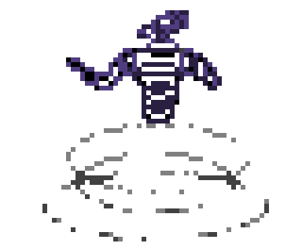
All Skull and Dust
Made Of Fire
A smoke cloud goes around the demon
First Demon Monster

